Slide 1
Gamify Your Classroom
Karen Phillips

Slide 2
Agenda
8:30 am – 11:30 am
11:30 am – 12:45 pm lunch
12:45 pm – 3:30 pm

Slide 3
Objectives
Identify the components of a game
Gamify the classroom
Incorporate 21st century skills in the classroom ( create, communicate)

Slide 4
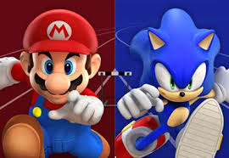
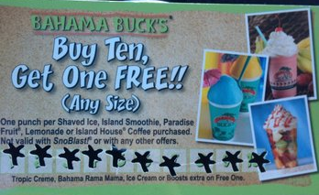
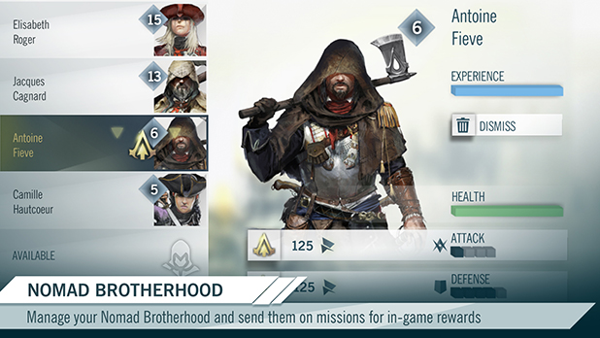
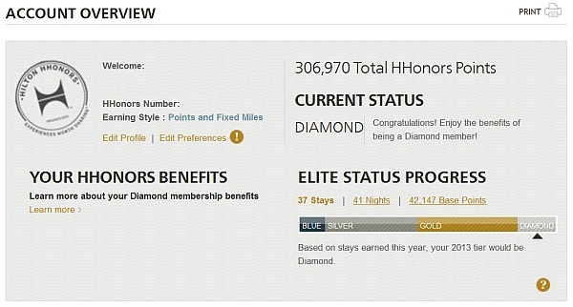
Why do people play games?

Slide 5
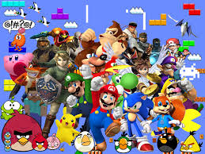
What are the characteristics of a game?

Slide 6
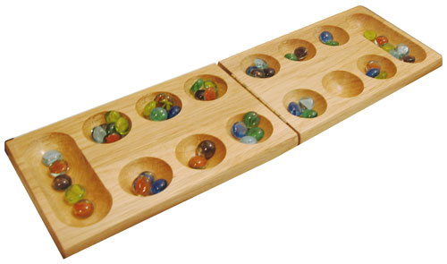
History of Games and Learning
Mancala- used as a distraction for Herodotus’s people
Senet – used to reinforce religious beliefs
Tic Tac Toe – used to teach strategic thinking
Risk and Stratego – some wars in WWI were attributed to tactics from the game
Pong – first commercial video game
Pac Man, Donkey Kong and Super Mario- used cut scenes as rewards ( badges of today)

Slide 7
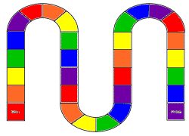
Are these considered games?
Review quizzes
Flashcards
Drill and kill questions/answers
Interactive activities
Simulations

Slide 8
What are the components of games?
Goal
Rules
Feedback system
***Voluntary participation***
Example: bowling
Learning games must be appealing to both teachers and students.
Resource: www.GamesandLearning.org

Slide 9
Voluntary Participation
Teacher-led games
Free-play
Work it or play it
Fun drives game design and motivation
Kids will be suspicious if a teacher calls it a game and it is not. ( adding a badge to student work)

Slide 10
Feedback System
Points
Badges
Leaderboards
Game mechanics and problem solving sets
Example: Dragon Box
Teaches algebra and the mechanic is solving equations.

Slide 11
The point of game-based learning is to deliver instruction, not to become the instruction. Matthew Farber

Slide 12
Flashcards vs. concentration
Sorting vs. Sortify
Crossword vs. Cut-Ups
Class discussion vs. Find-the-Clue

Slide 13
Competitive games tend to reward people who need the least help and punish those who need the most help especially if they are not playing it voluntarily.

Slide 14
Games can create conversations.

Slide 15
Rules
Rules describe the game’s mechanics.
Some can be taught prior to playing.
Many games teach the rules and goals during play.
Ex. Pac-Man ( an example of constructivist learning)

Slide 16
Goal
Objective or standard driven
Should be easy to identify
Authentic
Example: Rock-Paper-Scissors

Slide 17
Who Plays Games?
Player model ( Bartle, 1996)
Killers (those who act on, or against, other game players)
Achievers (those who build up their in-game status)
Explorers (those who gather artifacts and look around)
Socializers (those who build friendships)

Slide 18
Suggestions for Game Selection
Play the game
Select a game that does not directly teach the content ( shouldn’t replace you)
Authentic projects related to real-world situations
Intrinsic vs. extrinsic motivation
Element of a challenge
Fun ( sensation, fantasy, narrative, risky, etc.)

Slide 19
Toys vs. Games
Toys don’t have rules
Free-play
Manipulated
Combined together
Example: Sims, Toca Boca Apps,

Slide 20
Sandbox Games
Tool sets
Story based missions
Create
Communicate
Manipulate
Virtual environments
Example: MinecraftEdu

Slide 21
How do you Gamify your classroom?
It’s about the experience.
Activities designed to interest different types of players.
Rewards (achievements that could include points, payments, badges, discounts or free gifts)
Status indicators (progress bars, friend counts, re-tweets, and leveling up)
Quests for information
Eastereggs
Cheat codes

Slide 22
Edmodo
Classbadges
Classcraft

